Slide 1
Week 6 – Documenting Requirements
in Natural Language
Requirement Engineering
Book Pohl, Klaus. Requirements engineering: fundamentals, principles, and techniques.
Section 5
Fast-National University of computer & Emerging Sciences

Slide 2
Effects of Natural Language
Subjective perception
As natural language is inherently ambiguous and statements in natural lan- Subjective perception guage can often be interpreted in multiple ways.
Requirements are defined and read by people with different knowledge, different social backgrounds, and different experiences. The diversity among the people involved in the development processes may lead to misunderstanding as humans interpret information differently (they form a so-called “deep structure” in their mind) and thus construe it differently as well (e.g., as a requirement).
During such a process (i.e., perception and representation of information), so-called “transformational effects” occur that show different characteristics with every human but may occur in all humans

Slide 3
Effects of Natural Language
Transformational effects
The fact that transformational effects adhere to certain rules can be exploited by the requirements engineer to elicit the deep structure (i.e., what the author of a requirement really meant) from its surface structure (i.e., the requirements).
Five transformational processes that are most relevant for requirements
engineering:
Nominalization
Nouns without reference index
Universal quantifiers
Incompletely specified conditions
Incompletely specified process verbs

Slide 4
Effects of Natural Language
Nominalization
Reduction of processes
By means of nominalization, a (sometimes long-lasting) process is converted into a (singular) event. All information necessary to accurately describe the process is thereby lost.
The process word transmit turns into the noun transmission. Other typical examples of nominalization are the terms input, booking, and acceptance.
Example :
“In case of a system crash, a restart of the system shall be performed.” The terms system crash and restart each describe a process that ought to be analyzed more precisely.

Slide 5
Effects of Natural Language
Define processes completely.
Per se, there are no arguments against the use of nominalized terms to completely. describe complex processes. However, the process should be explicitly defined by the term used.
The definition of a nominalized term must not allow for any leeway in the interpretation of the processes and must precisely depict the process, including any exceptions that may occur as well as all input and output parameters. It is therefore not necessary to avoid nominalizations, but they should only be used if the underlying process is completely defined.
During the linguistic analysis of a text, all nominalizations ought to be examined to determine whether they have been defined in sufficient detail in another part of the requirements document and whether they are clear for all stakeholders. If this is not the case, another requirement or a glossary entry must be created

Slide 6
Effects of Natural Language
Nouns without Reference Index
Nouns with missing reference
As with process verbs, nouns are frequently incompletely specified.
Linguists call this a missing or inadequate index of reference. Examples of terms that contain incompletely specified nouns are the user, the controller, the system, the message, the data, or the function.
Example : Nouns without reference indices
The data shall be displayed to the user on the terminal.

Slide 7
Effects of Natural Language
The following questions arise: What data exactly? Which user exactly? Which terminal exactly? If this information is amended, the requirement might thus read as follows:
Example : Nouns with added reference indices
The system shall display the billing data to the registered user on the terminal she is logged in to.

Slide 8
Effects of Natural Language
Universal Quantifiers
Specify amounts and frequencies.
Universal quantifiers specify amounts or frequencies. They group a set of objects and make a statement about the behavior of this set.
When using universal quantifiers, there is the risk that the specified behavior or property does not apply to all objects within the specified set.
Stakeholders tend to group objects together, even though some of these objects might be special cases or exceptions, where the behavior specified does not apply to all the objects of a group.

Slide 9
Effects of Natural Language
Identify universal quantifiers.
It must be verified whether the specified behavior really applies to all
objects summarized through the quantifiers.
Universal quantifiers can be easily identified through trigger words such as never, always, no, none, every, all, some, or nothing.
Example : The system shall show all data sets in every submenu.
In this case, the following question must be asked: Really in every submenu? Really all data sets?

Slide 10
Effects of Natural Language
Incompletely Specified Conditions
Identify and clarify condition structures.
Incompletely specified conditions are another indicator of a potential loss of information. Requirements that contain conditions specify the behavior that must occur when the condition is met.
In addition, they must specify what behavior must occur if the condition is not met (the part that is often missing). Especially in complex conditional structures, decision tables can be invaluable tools to find unspecified variants of conditions or actions. Trigger words are, for instance, if … then, in case, whether, and depending on.

Slide 11
Effects of Natural Language
Example : Incompletely specified condition
The restaurant system shall offer all beverages to a registered guest over the age of 20 years.
At least one aspect remains unspecified in the example above: Which beverages shall be offered to a guest that is 20 years or younger? Clarifying this question may lead to extending the requirement as follows:
Example : More completely specified condition
The restaurant system shall offer
All alcohol-free beverages to any registered user younger than 21 years
All beverages including all alcoholic beverages to any user over the age of 20

Slide 12
Effects of Natural Language
Incompletely Specified Process Verbs
Completing process words
Some process verbs require more than one noun to be considered completely specified. The verb transmit, for instance, requires at least three supplements to be considered complete: what is being transmitted, from where it is being transmitted, and to where it is being transmitted.
The feel for language (also referred to as “Sprachgefühl”) is a valuable tool to help gauge which process word must be supplemented in order to be considered complete. Similarly, adjectives and adverbs may need to be supplemented as well. While the effect is much less frequent with these types of words than with verbs, it is often hard to recognize.

Slide 13
Effects of Natural Language
Avoid passive voice.
The use of incompletely specified process words can mostly be avoided or kept to a minimum if requirements are formulated using the active voice rather than the passive voice.
Example : Requirement using the passive voice
To log a user in, the login data is entered.
Use active voice
In this requirement using passive voice, it is unclear who enters the login Use active voice. data. It is also unclear where and how this is done. If this requirement is reformulated using the active voice, at least the agent or person responsible must be included. The same requirement using active voice might be as follows:
Example : Requirement using active voice
The system must allow the user to enter his user name and password using the keyboard of the terminal.

Slide 14
Requirement Construction using Templates
Quality by means of requirements templates and glossaries
Definition : A requirements template is a blueprint for the syntactic structure of individual requirements.
Requirements templates provide a simple and easily understandable
approach to reduce language effects when documenting requirements.
Templates support the author in achieving high quality and syntactic unambiguousness in optimal time and at low costs.
In order to achieve lexical clearness in the documentation as well, it is wise to use requirements templates in conjunction with project glossaries

Slide 15
Requirement Construction using Templates
Step-by-step description of the correct application of requirements
templates.
Step 1 Determine the Legal Obligation How legally binding is a requirement?
Usually, one distinguishes between legally obligatory requirements, urgently recommended requirements, and future requirements.
To achieve this within a requirement, you can use the modal verbs shall, should, and will. Alternatively, the legal obligation of a requirement can be documented by a specific requirements attribute.

Slide 16
Requirement Construction using Templates
Step 3: Characterize the Activity of a System
For functional requirements, the system activity can be classified as one of three relevant types:
Autonomous system activity: The system performs the process autonomously.
User interaction: The system provides the process as a service for the
user.
Interface requirement: The system performs a process depending on a third party (e.g., another system). The system is passive and waits for an external event.

Slide 17
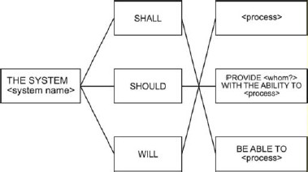
Requirement Construction using Templates
After performing steps 1 through 3, the structure of the requirement has been developed . The words that are written in angle brackets must be replaced accordingly.

Slide 18
Requirement Construction using Templates
Type 1: Autonomous system activity
The first template type is used when requirements are constructed that depict system activities that are performed autonomously. The user does not interact with the activity. We define the following requirements template:
THE SYSTEM SHALL/SHOULD/WILL/ <process verb>
Type 2: User interaction
<Process verb> depicts a process verb as described in step 2, e.g., print for print functionality or calculate for some calculation that is performed by the system.
If the system provides a functionality to a user (for example, by means of an input interface), or the system directly interacts with a user, requirements are constructed using template type 2:
THE SYSTEM SHALL/SHOULD/WILL/ provide <whom?> with the ability to <process verb>

Slide 19
Requirement Construction using Templates
Type 3: Interface requirement
The user that interacts with the system is integrated into the requirement through <whom?>.
If the system performs an activity and is dependent on neighboring systems, the third template type is to be used. Whenever messages or data are received from a neighboring system, the system must react by executing specific behavior. The following template has proven itself as well suited:
THE SYSTEM SHALL/SHOULD/WILL/ be able to <process verb>

Slide 20
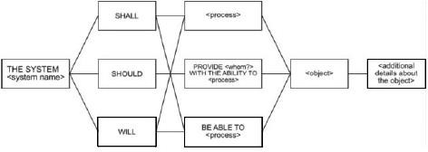
Requirement Construction using Templates
Step 4: Insert Objects
Complete process verbs.
Some process verbs require one or more additional objects to be considered. In step 4, potentially missing objects and supplements of objects (adverbials) are identified and added to the requirement. For instance, the requirements template for the process verb print is amended by the information of what is being printed and where it is printed.

Slide 21
Requirement Construction using Templates
Step 5: Determine Logical and Temporal Conditions
Add conditions
Typically, requirements do not document continuous functionalities, but functionalities that are performed or provided only under certain logical or temporal constraints.
In order to easily differentiate between logical and temporal conditions, we choose the temporal conjunction as soon as for temporal conditions and the conditional conjunction if for logical conditions.
The conjunction when makes not clear whether a temporal or a logical condition is described and should therefore be avoided. In step 5, quality requirements that describe the conditions under which a requirement
is fulfilled are added to the beginning of a requirement as a subordinate
clause.
21

Slide 22
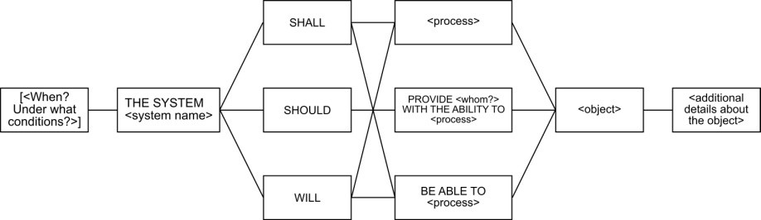
Requirement Construction using Templates
Requirements templates should be used when project members show interest in a formal development process.
Style and creativity are harshly limited when requirements templates are used. Experience shows it is best not to make the use of requirements templates compulsory, but to offer training on the method and treat it as a supplemental tool.

Slide 23
Summary
System requirements are frequently documented using natural language. Typical advantages that arise from natural language requirements are good readability of requirements, the fact that natural language can be universally applied to document any circumstance, and the fact that no prior knowledge is necessary regarding the notation.
On the other hand, there are a number of disadvantages that arise from the fact that natural language requirements are not formalized, e.g., ambiguity. Since project members interpret requirements differently due to differences in their respective knowledge, social background, and experiences, using natural language for requirements documentation often leads to misunderstanding in practice. These disadvantages can be minimized during requirements documentation—for example, by making use of requirements templates and by checking the requirements against linguistic effects.

Slide 24
References
Pohl, Klaus. Requirements engineering: fundamentals, principles, and
techniques.(Chapter 5).

